Slide 1


Friday Training Hour
“Python beyond the Basics”
Anthony McKale Principal Engineer
30/04/2021

Slide 2
Python beyond the basics
Today we’ll cover :
Classes
Modules
Plugins
It’ll aim to cover the class portions of the official python tutorial
https://docs.python.org/3/tutorial/

Slide 3
PYTHON CLASSES

Slide 4
Python : What is a Class ?
“A class is written by a programmer in a defined structure to create an object … . It defines a set of properties and methods that are common to all objects of one type.”
Wikipedia:
https://simple.wikipedia.org/wiki/Class_(programming)

Slide 5
Python : What is a Class ?
Aka it’s a :
Variable container you can create multiple instances of (self variables)
Attach functions to that container (instance functions)
Attach functions and variables to the definition of the class (static variables and functions)
Classes can extend one another for complex behaviours (inheritance)

Slide 6
Python : Basic Class Parts
Constructor (initial function that setups up class __init__)
Static Variables
Static Functions
Functions
Variables

Slide 7
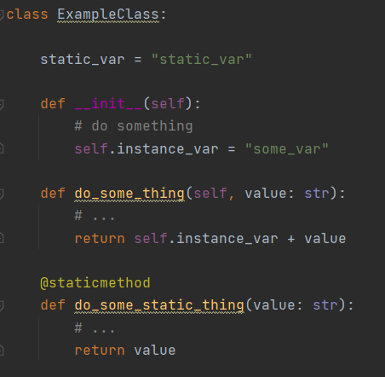
Python : Basic Class Parts
Constructor
Variables
Functions
Static Variables
Static Functions

Slide 8
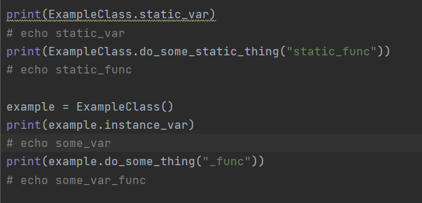
Python : Basic Class Parts

Slide 9
Python : Class Questions ?
Questions ?
Onto inheritance

Slide 10
PYTHON CLASS
INHERITANCE

Slide 11
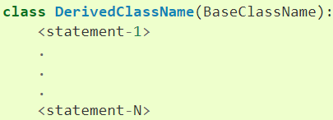
Python : Nested Classes Why ?
Python can nest (extend) classes This is where you have a base class, and classes that extend that
Overwriting / Adding new functions and variables
https://docs.python.org/3/tutorial/classes.html#inheritance

Slide 12
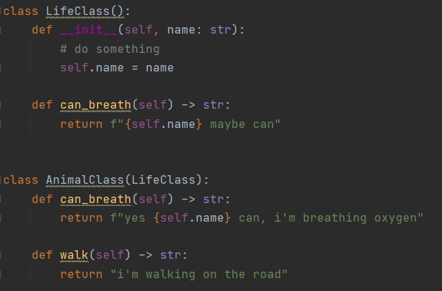
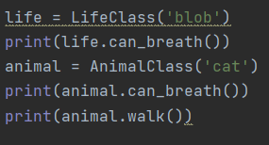
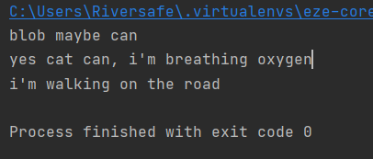
Python : Life / Animal Terrible Example
We have two classes, Life and it’s child Animal Life can maybe breath, Animal’s can definitely breath and they can walk

Slide 13
Python : Class Inheritance Questions ?
Questions ?
Onto ABC

Slide 14
PYTHON ABC CLASSES

Slide 15
Python : Abstract Base Class
Sometimes you define a Abstract Base Class
ABS is a class without working code, that is made to be extended and finished
Class that extend a ABC overwrite the functions providing implementation
This is a very common pattern
SPEC: https://www.python.org/dev/peps/pep-3119/

Slide 16
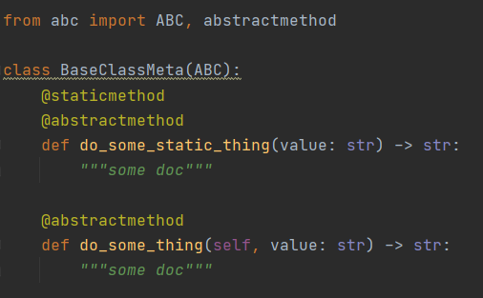
Python : ABC in python
abc package provides this functionality
With @abstractmethod annotation
and “abc” base class to extend
https://docs.python.org/3/library/abc.html

Slide 17
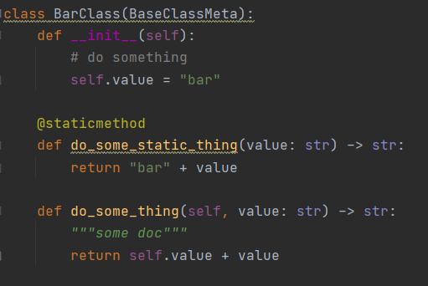
Python : ABC in python
Example
https://docs.python.org/3/library/abc.html

Slide 18
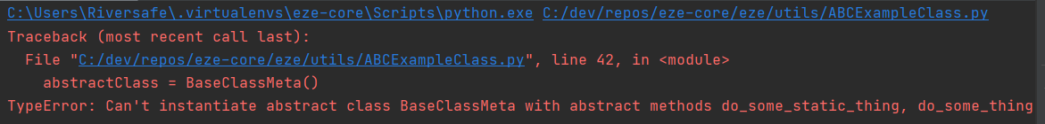
Python : ABC in python
Abstract base class will throw errors on init
https://docs.python.org/3/library/abc.html
abstractClass = BaseClassMeta()

Slide 19
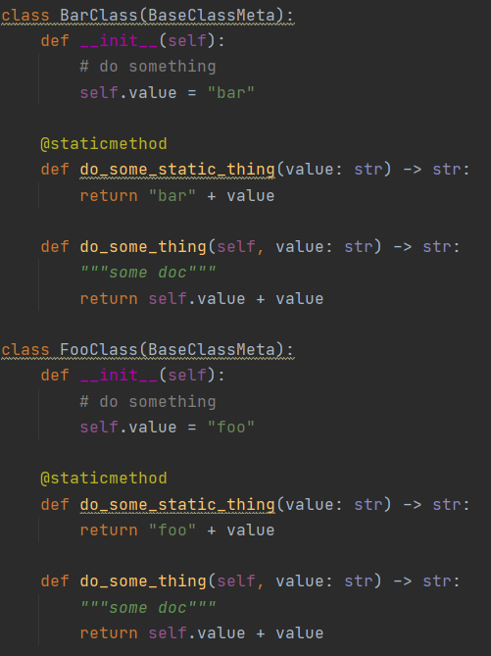
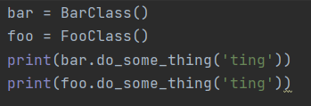
Python : ABC in python
Basic Example

Slide 20
Python : Abstract Base Class Meta Commentary
Aka for example… Say I’m building a Scanning engine that can take multiple tools
But I want to call the same functions for each tool
Create AbstractTool Class with common callable functions
Implement AbstractTool as say BlackDuckTool, SafetyTool and CheckmarksTool
Then my code can accept AbstractTool and call the common functions, and each function is finished off in the Final Classes

Slide 21
Python : ABC Questions ?
Questions ?
Onto Special Cases
Exception
Private vars
Setters and Getters
Reflection

Slide 22
PYTHON SPECIAL
CLASS
STUFF

Slide 23
Python : Exception (tip-toe)
Exception is a special class used for try/except/raise functionality
All “raised” objects should extend base python “Exception” Class
Ps there can dragons here
(special rules apply. Read documentation before messing with Exception)
https://docs.python.org/3/whatsnew/2.5.html#pep-352-exceptions-as-new-style-classes
https://docs.python.org/3/library/exceptions.html#Exception

Slide 24
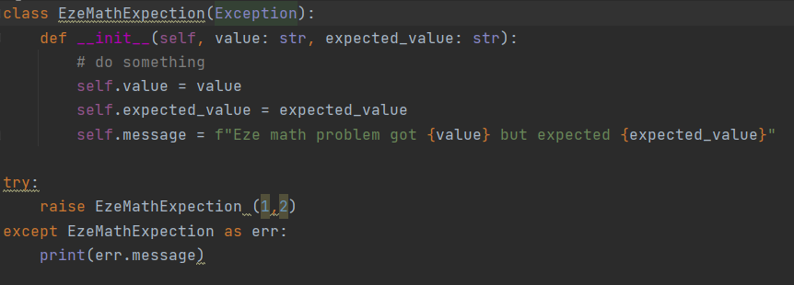
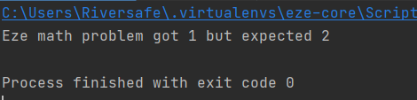
Python : Exception Example

Slide 25
Python : Private Stuff
Sometimes you want functions and variables to be accessible only by the class it’s self This is done via a double underscore prefix “__”
Aka __mr_private_var or __mr_private_func
https://docs.python.org/3/tutorial/classes.html#private-variables

Slide 26
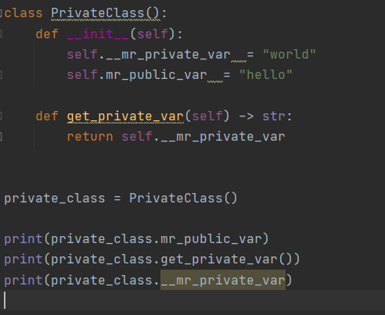
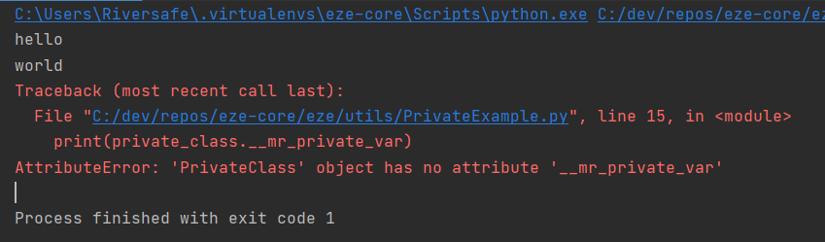
Python : Private Example

Slide 27
Python : Magic setter and getters
Wouldn’t it be great if I could call any function or variable, and get a reply? This is called magic setters and getters
Done via __get__ /__set__ / __getattr__ / __setattr__ and __delete__ (also __dict__ but that’s for another day)
https://docs.python.org/3/whatsnew/2.2.html#descriptors function level detail here...
https://python-reference.readthedocs.io/en/latest/docs/dunderattr/getattr.html

Slide 28
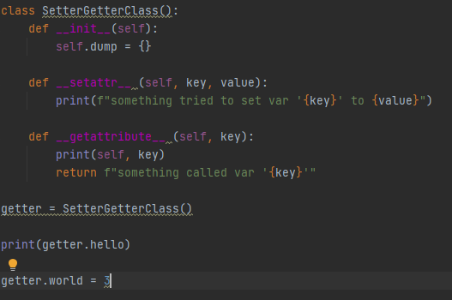
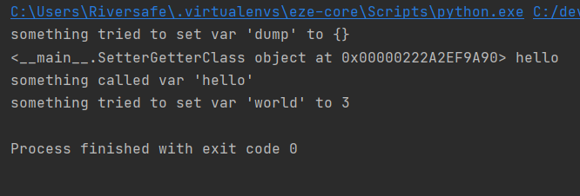
Python : Magic SG Example
. Ps excessive Getting and Setting is considered poor practice and is typically done by tooling code

Slide 29
Python : Reflection (tip-toe)
Sometimes you want to dynamically* know the structure of a class, or what line something is running / breaking on
This is called reflection, this is complex but the way this is done via the reflection library
This is normally done for you, but this is how unit tests and other tools get the exact line numbers
https://docs.python.org/3.6/c-api/reflection.html
https://docs.python.org/3/whatsnew/2.2.html#descriptors

Slide 30
Python : Class Questions
Class questions ?

Slide 31
PYTHON MODULES

Slide 32
Modules
A module is basically just a py file containing statements
These can be classes, functions, executable code, and links to other modules
Multiple Modules* are used when your app gets bigger than a single file * rule of thumb, proactively split files bigger than 200-300 lines of code into sub modules

Slide 33
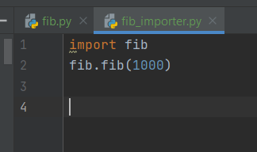
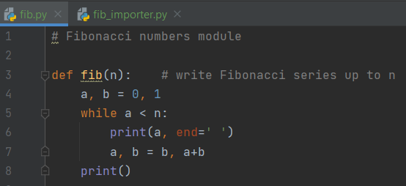
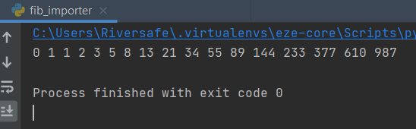
Modules
One module can reference another via the “import” statement
This pulls in that module into the requester aka

Slide 34

Self Executing Modules
For when you what to run a module as a run you need to bootstrap them using the __name__ magic variable and a if
using sys.argv for getting variables
https://docs.python.org/3/tutorial/modules.html#executing-modules-as-scripts

Slide 35
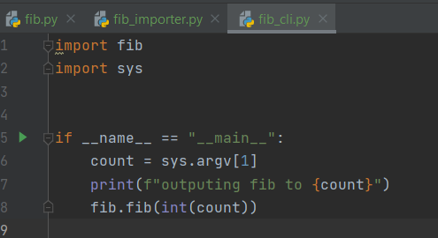
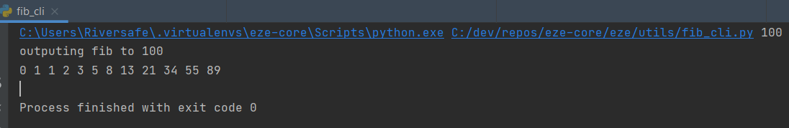
Self Executing Module Example

Slide 36
Finding Modules
Modules are discovered in multiple ways
Same Directory
Relative Packages (aka dotted format links to modules in other folders )
Pip installed modules (aka pip install xxx)
Standard Python Modules (aka inbuilt aka sys)
Will briefly speak about these

Slide 37
Finding Modules: Same Directory
Obvious right
For entire python file:
import xxx (for file xxx.py)
For particular Class or Function in python file:
from xxx import name (for file xxx.py, and name)
You can also rename things
from xxx import name as new_name

Slide 38
Finding Modules: Relative Packages
Package is just a folder with a __init__.py file in it
All packages require a __init__.py
Without it you won’t be able to reference those py files in that folder
Ps DO NOT BE CLEVER AND ADD CODE INTO __init__.py !!!
It’s the road to hell

Slide 39
Finding Modules: Relative Packages
For importing a module as a package:
import dir1.dir2.xxx (for file xxx.py)
For importing a pip module as a package:
import pip_name.dir1.dir2.xxx (for file xxx.py inside pip_name)
(from / import and as work as before)

Slide 40
Finding Modules: Pip installed modules
Everything you pip install is added to your pip libs
Pip libs directory is on your PYTHONPATH env var (including your current execution directory) Python will in order search for packages from your PYTHONPATH aka check locally, then your system inbuilt packages, then your pip folder, then etc etc

Slide 41
Finding Modules: Pip example
SHOW IN IDE PATH AND IT WORKING

Slide 42
Questions?: Modules
Questions ?

Slide 43
PLUGINS

Slide 44
Missing Knowledge Check
How to package a module for pip Cliffnotes:
install setup_tools
create a pyproject.toml
create a setup.py
Profit
I’ll assume you know this, otherwise further reading here:
https://setuptools.readthedocs.io/en/latest/index.html

Slide 45
Plugins
What if you want a module to :
Discover what modules are installed ?
Discover related modules ?
Welcome to python plugins

Slide 46
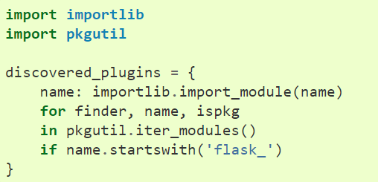
Plugins: Discovering Modules
Two std libraries in python are importlib and pkgutil
Unlikely you’d need to directly use these, but good to know
Example of getting all modules
Starting with flask_

Slide 47
Plugins
Three ways of discovering plugins:
Naming convention (aka all modules prefixed “pytest_” on previous slide)
Namespacing* (aka sub modules, variant of Naming convention)
Package entry_points (aka plugin module explicitly declares it’s connection to module in it’s setup.py)
https://packaging.python.org/guides/creating-and-discovering-plugins/
* For more info on namespacing* (it’s a advanced sub-module technique) see https://packaging.python.org/guides/packaging-namespace-packages/

Slide 48
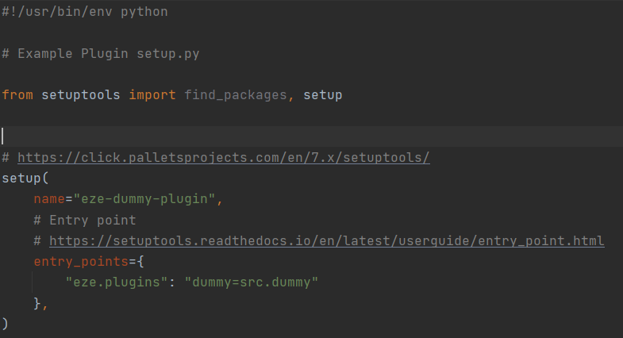
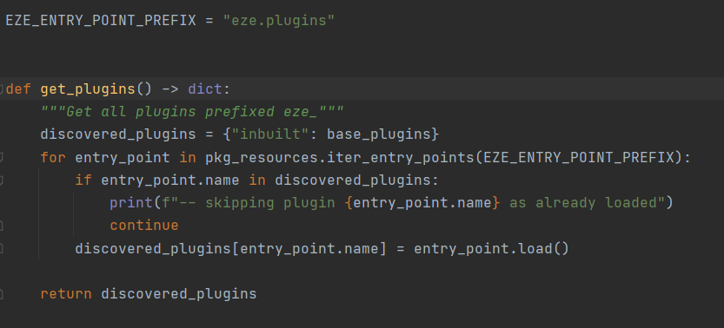
Eze Plugins
Eze uses Package entry_points
Modules say there entry_point is “eze.plugins” and it’s found when the eze module is run

Slide 49
Plugins Questions ?
.

Slide 50
Further
Reading

Slide 51
Further Python Training:
Luckily we’re drowning in further resources here’s some further reading
https://docs.python.org/3/tutorial/classes.html
https://docs.python.org/3/library/abc.html
https://docs.python.org/3/tutorial/modules.html
https://packaging.python.org/guides/creating-and-discovering-plugins/
https://setuptools.readthedocs.io/en/latest/index.html

Slide 52
Questions
I’ve been Anthony M^{c}Kale “Wizard without Portfolio” Fixer-Upper of Broken things, and creator of time-constrained workable Fudges for 15 years. Email : anthony@zapper.hodgers.com

Slide 53
Thank
you

